Slide 1



Shark Tank USA Analysis
View in Power BI
Last data refresh:
11/05/2025 01:54:22 UTC
Downloaded at:
11/05/2025 01:55:32 UTC

Slide 2
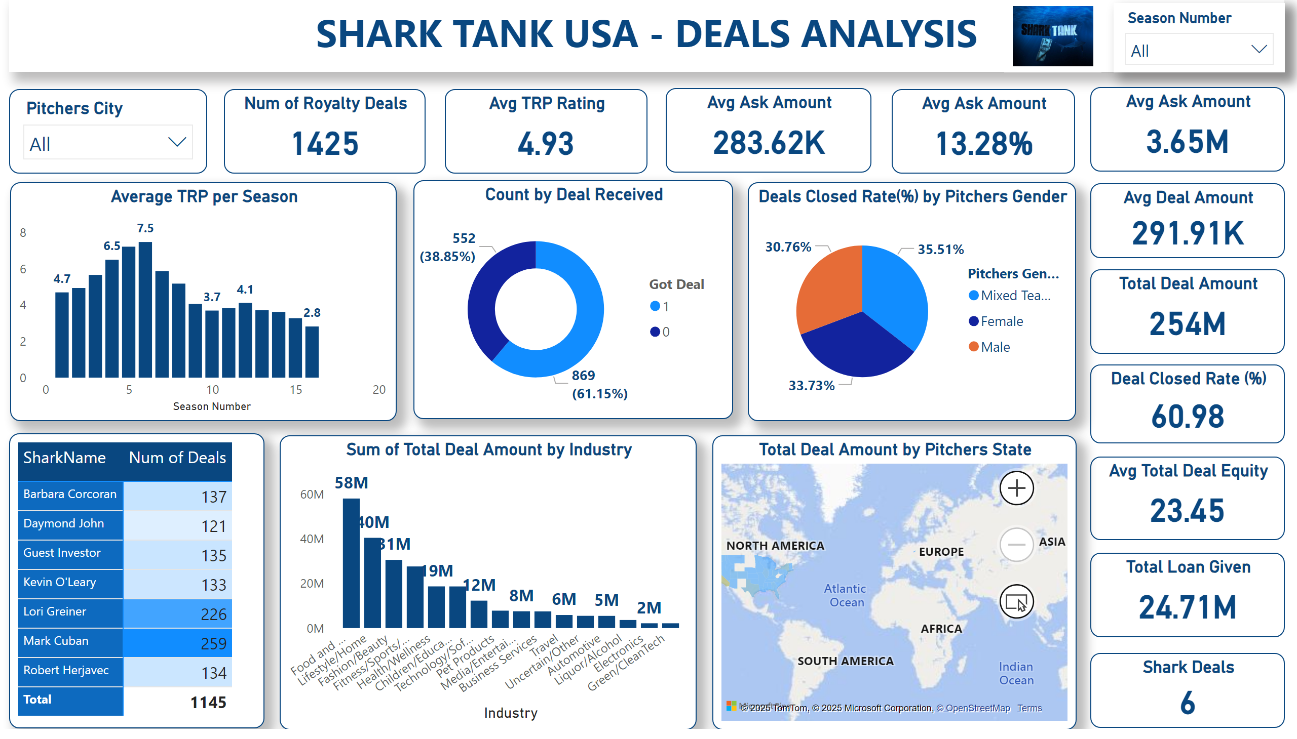
Page 1
Notes:
textbox
No alt text provided
image
No alt text provided
slicer
No alt text provided
Num of Royalty Deals
No alt text provided
slicer
No alt text provided
Avg TRP Rating
No alt text provided
Average TRP per Season
No alt text provided
Avg Ask Amount
No alt text provided
Avg Ask Amount
No alt text provided
Avg Ask Amount
No alt text provided
Count by Deal Received
No alt text provided
Avg Deal Amount
No alt text provided
Total Deal Amount
No alt text provided
Deal Closed Rate (%)
No alt text provided
pieChart
No alt text provided
pivotTable
No alt text provided
columnChart
No alt text provided
Avg Total Deal Equity
No alt text provided
Total Loan Given
No alt text provided
Total Deal Amount by Pitchers State
No alt text provided
Shark Deals
No alt text provided

